Slide 1
Multicloud Infrastructure Automation
“ Take your cloud journey to the next level ”
Team: Strategic Squad

Slide 2
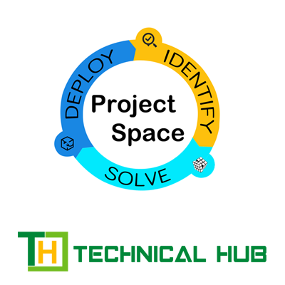
Multicloud Infrastructure Automation
Overview
01
02
03
04
Introduction
Problem
Theoretical
Objectives
05
06
07
08
Implementation
Research Data
Alternative Concepts
Conclusion

Slide 3
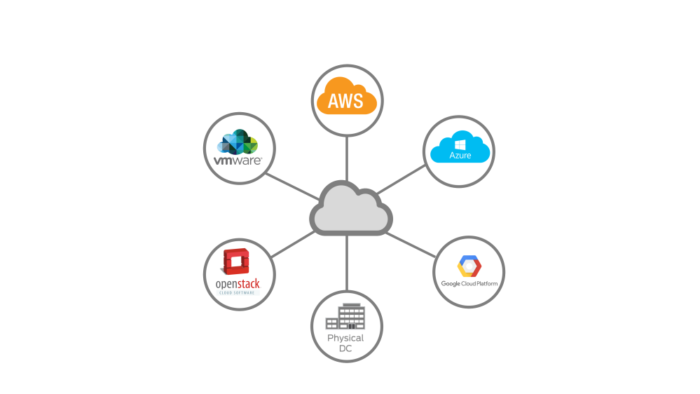
Multicloud Infrastructure Automation
Thesis Defense
Introduction
01
Multicloud infrastructure automation is the practice of automating the management and deployment of resources across multiple cloud environments, such as Amazon Web Services (AWS), Microsoft Azure, and Google Cloud Platform (GCP).
The goal of multicloud infrastructure automation is to streamline the process of managing resources across multiple cloud providers by using automation tools and processes. This can help organizations to achieve greater agility, efficiency, and scalability, while reducing the risk of errors caused by manual processes.

Slide 4

Multicloud Infrastructure Automation
Problem
02
First Problem
Second Problem
Managing multiple cloud platforms can be complex and time-consuming, requiring IT teams to have expertise in each cloud provider's tools and services
Manual infrastructure management tasks, such as provisioning resources, deploying applications, and configuring security settings, can be time-consuming and error-prone

Slide 5
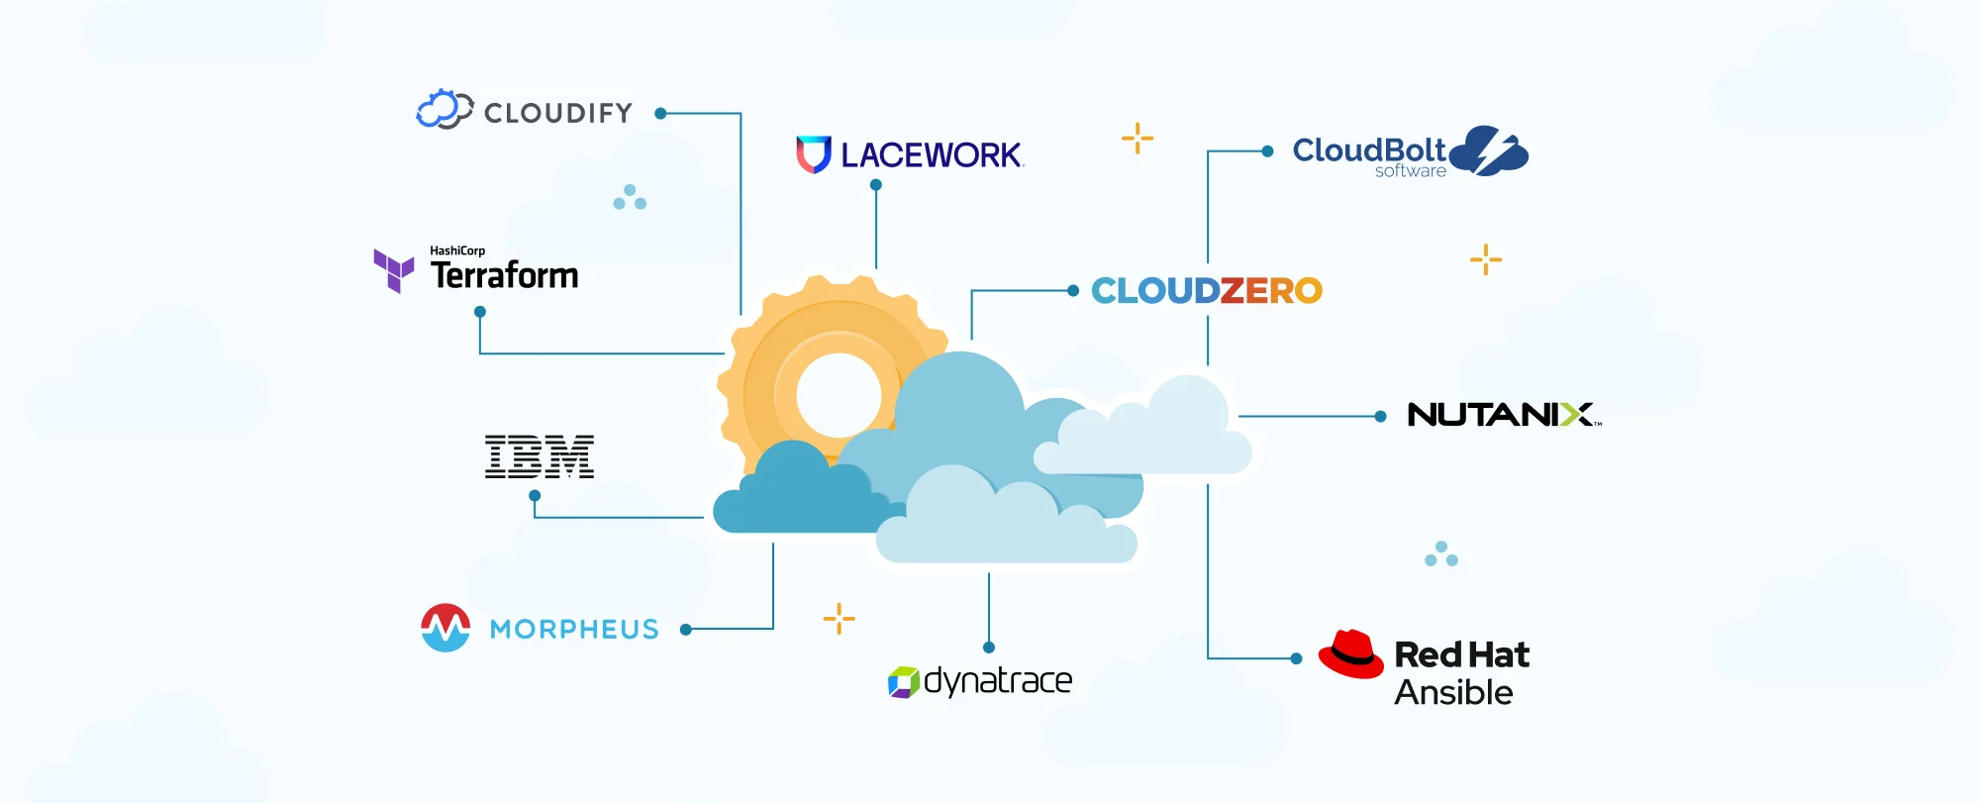
Theory of Multicloud
Multicloud Infrastructure Automation
Multicloud refers to the practice of using multiple cloud computing services from different providers, such as Amazon Web Services (AWS), Microsoft Azure, and Google Cloud Platform (GCP), to meet an organization's computing needs. In other words, instead of relying on a single cloud service provider, an organization uses a combination of cloud services from multiple providers.
Theoretical
03
Theory of Automation
Automation in cloud computing refers to the use of tools, scripts, and processes to automate the management of cloud infrastructure and services. Automation can help organizations to increase efficiency, reduce costs, and improve the reliability and performance of their cloud environments.

Slide 6
Multicloud Infrastructure Automation
Objectives
04
The First Objective
To scale the cloud environments more easily by automating the deployment and configuration of cloud resources.
The Second Objective
To automate the deployment and configuration of infrastructure across multiple cloud providers
By achieving these objectives, Multicloud Infrastructure Automation can help organizations to achieve greater agility, flexibility, and resilience in their cloud environments, while reducing costs and improving security and compliance.
The Third Objective
To improve the reliability of cloud environments by reducing the risk of human error and ensuring consistent configuration of resources across all clouds.

Slide 7

Multicloud Infrastructure Automation
Implementation
05
The First Phase
The Second Phase
The Third Phase
In this phase we launch multiple services in single cloud using CloudFormation.
In this phase we write a code in HCL(HashiCorp Configuration Language) to launch the required service using the TERRAFORM tool.
In this phase we deploy the service in different clouds with minor changes in the YAML or JSON code.

Slide 8
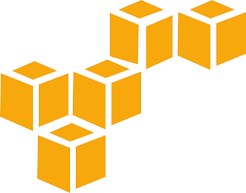
Multicloud Infrastructure Automation
Research Data
First Period Research
AWS CloudFormation is a service that allows you to provision and manage AWS resources using templates. With CloudFormation, you can define your infrastructure as code using a template, which can be version controlled, reviewed, and tested before being deployed.
06
Third Period Research
Second Period Research
Automation refers to the use of technology to perform tasks or processes that would otherwise be done manually by humans. Automation can help reduce the time and effort required to perform repetitive or complex tasks, and can also help improve consistency and accuracy.
Terraform is an open-source tool developed by HashiCorp that enables you to provision and manage infrastructure as code across multiple cloud providers, including AWS, Azure, Google Cloud Platform, and more. Terraform uses a declarative syntax to describe the desired state of your infrastructure, allowing you to automate the creation, update, and deletion of resources.

Slide 9
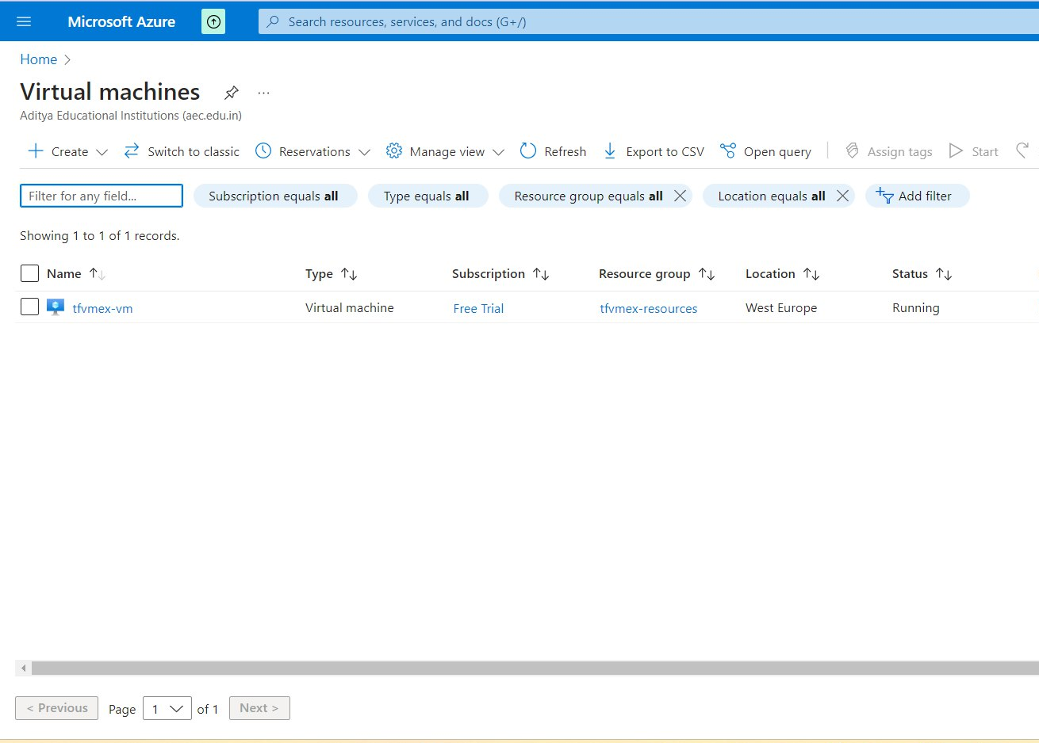
Multicloud Infrastructure Automation
Alternative Concept
07
AZURE TECHNOLOGY
Azure is a cloud computing platform and services from Microsoft. Azure offers a wide range of cloud services including virtual machines, web and mobile applications, storage, and more. Azure enables organizations to build, deploy, and manage applications and services in a scalable, secure, and reliable way.

Slide 10
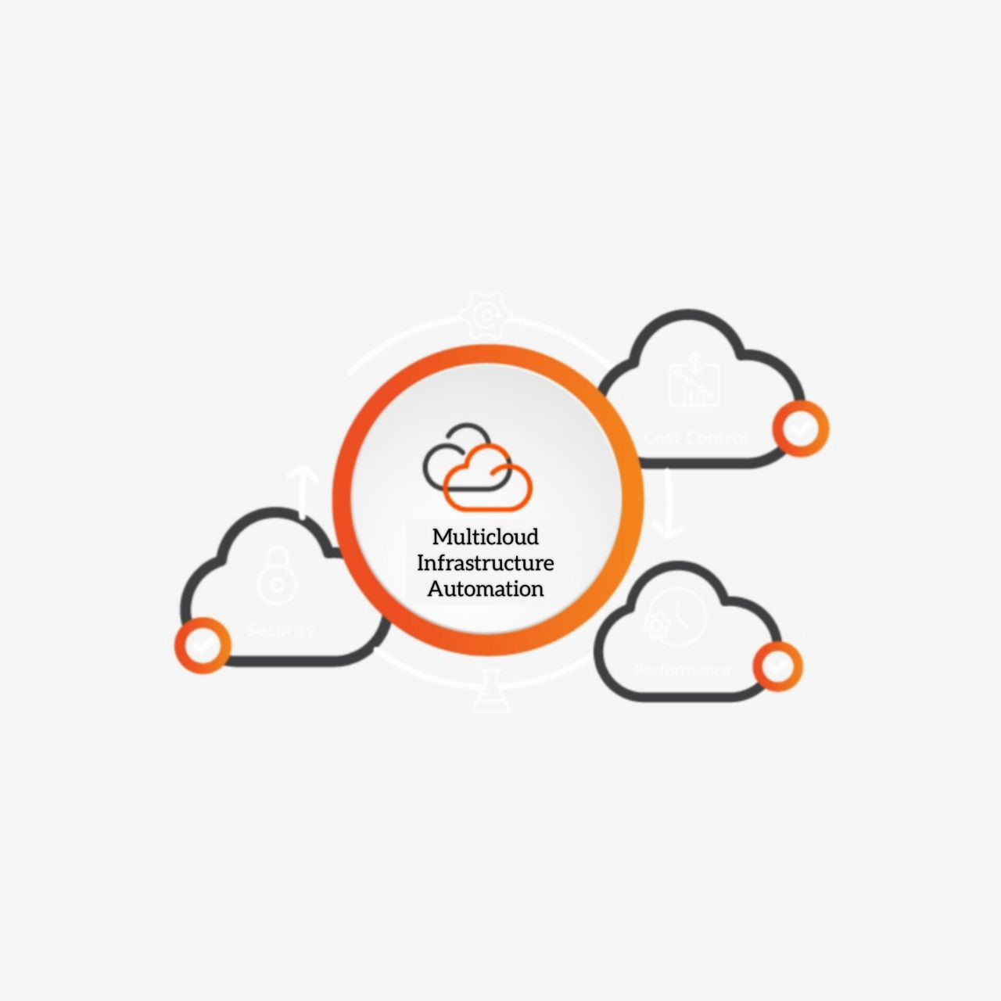
Multicloud Infrastructure Automation
Conclusion
08
The scope of multicloud infrastructure automation can vary depending on the specific needs and objectives of the organization. However, in general, the goal is to automate as much of the infrastructure management and deployment process as possible, while maintaining control and visibility across multiple cloud environments.

